Slide 1


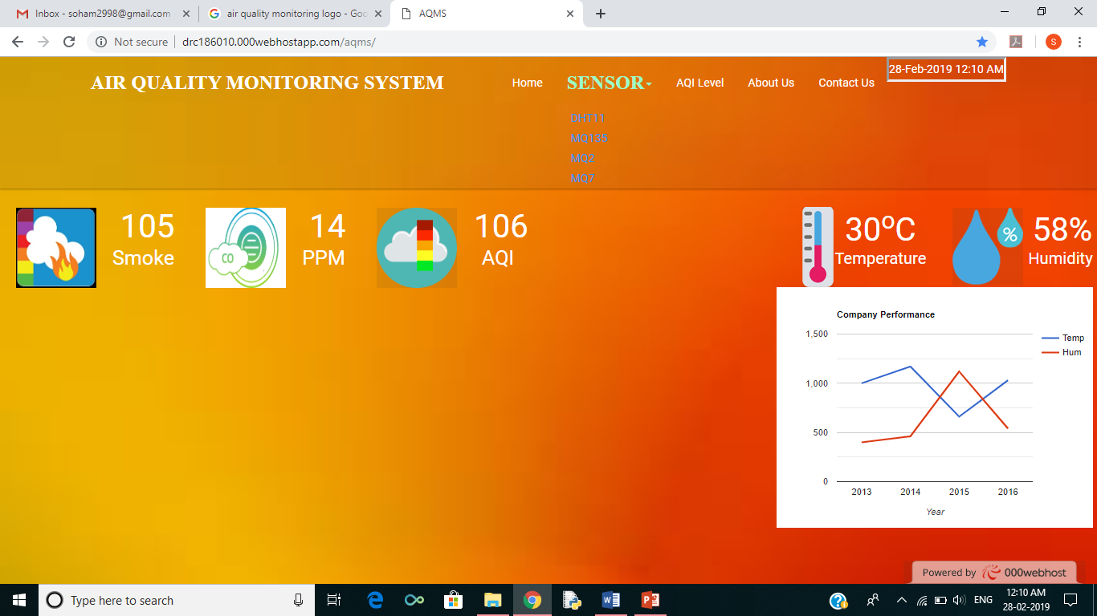
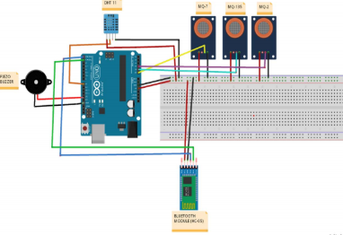
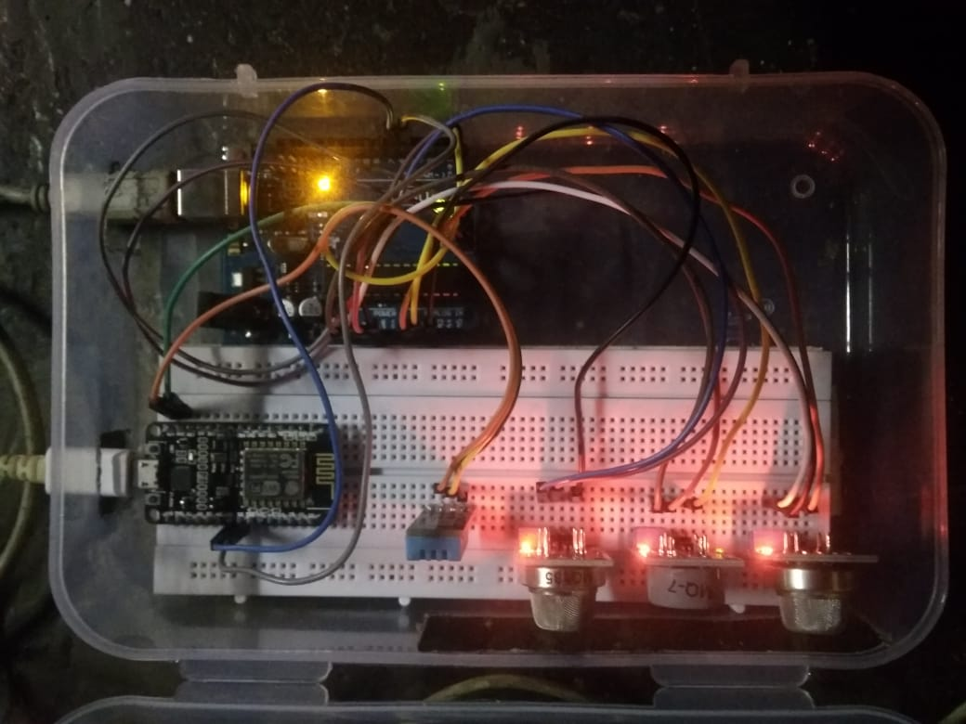
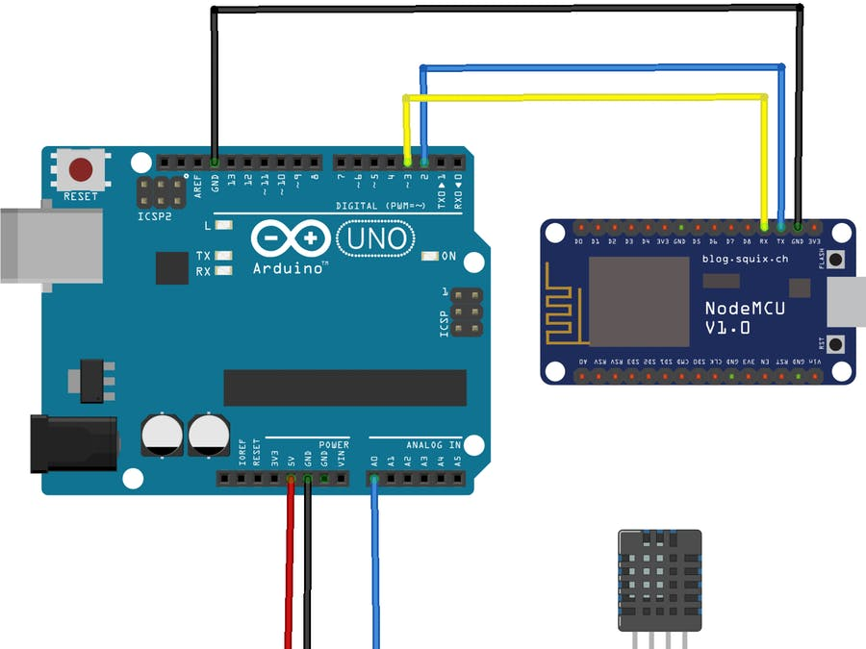
AIR QUALITY MONITORING SYSTEM
TEAM MEMBERS : AMRUTA,DEEPAK,SOHAM,SURAJ
XAVIER INSTITUTE OF ENGINEERING, MAHIM
ABSTRACT
DESIGN PHASE
IMPLEMENTATION
CONCLUSION
We propose a IOT based Air Quality Monitoring system with features designed to monitor the air quality.
This device consists of a system that reads different parameters generated by sensors that causes pollution and help us to control it.
The technology adopted is a practical implementation of the concept of Internet of Things.
These monitoring systems are important in many smart city projects for monitoring air quality and for controlling the main pollutant concentrations.
This project is an exploration of the possibilities of use of this technology in a rapidly changing world where environmental health is becoming a serious threat.
Selection of Components
The Arduino UNO R3 board was used as it simplifies the amount of hardware and software development. Arduino IDE provides a number of libraries to make programming the microcontroller easier.
Arduino allows programming and serial communication over USB. Once loaded the USB can be disconnected and the Arduino will be updated with the latest code compiled.
For gas detection and monitoring, sensors are used which checks two conditions, one is the temperature and humidity and other is the gas level detection. DHT11 is appropriate to monitor the ambient temperature and humidity, and MQ2, MQ7, MQ135 gas sensors detect smoke, CO, NH3 gas smoke AQI levels respectively.
The wireless mode of transmission was adopted using node MCU this requires an active Internet connection so it can be implement anywhere and it can effectively transmit data nearby.
NodeMCU is an open source IoT platform.It includes firmware which runs on the ESP8266 Wi-Fi SoC from Espressif Systems, and hardware which is based on the ESP-12 module.
The implementation starts by mounting the four sensors namely MQ2, MQ7, MQ135 and DHT11 on the bread board and connected to the Arduino. Extra Vcc to any of the sensors is provided by node MCU which has integrated esp8266 Wi-Fi module.
The sensors once connected with arduino and node MCU we will start sensing the environment’s air and give readings using Arduino IDE. The data collected in the Arduino is send to node MCU.
We use a cloud storage which stores this data received from the sensors using node MCU which transmits data to cloud using Wi-Fi. Data is uploaded into the database periodically.
The data collected from the sensors is displayed in the webpage which keeps us updated with the air quality around our vicinity.
We can also see the time data in the webpage for sensors separately. Graphical representation of the air quality also will be shown on the main page to show the data fluctuations .
We can also search data from database according to date. linear regression algorithm is used prediction. AQI value is also generated and air quality assessment is also displayed.
Environment is a complex issue in terms of toxicology and health risk assessment. There are many different types of pollutants which may give rise to combined effects. To stop the pollution we need to spread awareness among people. It has been seen that on awareness of the air pollution situation first-hand with real time data there have been changes in behaviour that lead to healthier choices that are beneficial to the environment as well. Thus, this project work aims at the design and development of an easy and quick monitoring system using low cost portable gas sensing systems. Integration with wireless network is very much useful for carrying out air pollution monitoring over an area and can report air quality in real time through Wireless Network. It will also solve the problem of analyzing and monitoring air pollution, and also to assist in establishing priorities and measurements of air pollution in the Area. So this project can provide real-time information about the level of air pollution in a particular region through the website / android app upon measuring the air pollutant concentrations using this project by implementing in a particular area . This information can then be used by the authorities to take prompt actions such as alerting people about the air pollution, evacuating people or sending emergency response team
OBJECTIVE
The main objective of IOT Air Monitoring System is to check air quality and keep it under control for a better quality and healthy living for all.
To enable swifter and immediate response by the authorities by providing a effective emergency alerting service in situation where the air quality is degrading.
To implement a practical system using Internet-of-Things(IoT) that ensures timely recording data regarding different pollution causing parameters.
To allows the officials to monitor air pollution in different areas and act against it. And if system detects hazardous air quality it alerts authorities so they can take measures to control the issues.
To understand and employ real world applications of concepts under Internet-of-Things (IoT) and make use of remote data accessing using cloud computing and real-time
REFERENCES
“7 million premature deaths annually linked to air pollution”, World Health Organisation Media Center, March 2014. http://www.who.int/mediacentre/news/releases/2014/airpollution/en/
“WHO releases country estimates on air pollution exposure and health impact”, World Health Organisation Media Center, September 2016, http://www.who.int/mediacentre/news/releases/2016/air-pollutionestimates/en/
N. Castell, M. Viana, C. Guerreiro. “Real-world application of new sensor technologies for air quality monitoring”, European Topic Centre on Air Pollution and Climate Change Mitigation, January 2014.
S. Devarakonda, P. Sevusu, H. Liu, R. Liu, L. Iftode, B. Nath, “Real-time air quality monitoring through mobile sensing in metropolitan areas”, Rutgers University, Piscataway, NJ, June 2013.
INTRODUCTION
Air pollution is both an environmental and a social problem, as it leads to adverse effects on human health, ecosystems and the The use of multiple parameters for air quality monitoring makes it possible to do a detailed level analysis of major pollutants and their sources. This project is an exploration of the possibilities of use of this technology in a rapidly changing world where environmental health is becoming a serious threat. Using Arduino, data is collected and sent to database and required work is implemented on the data gathered. A few sensors are also used such as temperature and humidity sensors and a few gas sensors to monitor changes. In this IOT project, we can monitor the pollution level from anywhere using your computer or mobile. We can install this system anywhere and it can also provide a notification when air quality goes beyond some level.
Circuit Connection of the components
CONTACT
Circuit Connection of Arduino and node MCU
AMRUTA BHAT : 9167551827
DEEPAK CHAURASIA : 8692830751
SOHAM BHOGALE : 7738324099
SURAJ JAYSWAL : 8879798042

